Slide 1


Project Title : (Secure Mailbox)
Developed By
Md. Mazharul Islam
ID: 171-35-1798
Department of Software Engineering
Faculty of Science and Information Technology
Daffodil International University
Supervised By
Ms. Afsana Begum
Assistant Professor
Department of Software Engineering
Faculty of Science and Information Technology
Daffodil International University

Slide 2
Project Content
Motivation
Diagram
Objective
User Interface
Stakeholders
Future Scope
Features
Github Link
Tools & Technology

Slide 3
Motivation
Every day, we use a lot of applications to communicate. That is why I was thinking about how to make an application where I can make communication easier and keep user data safer.
That is the reason why I developed a web-based e-mail application where users can communicate easily and where user data is safer.
Also, users can use some extra features that does not exist in other e-mail applications.
Live Chat
File Encryption/Decryption

Slide 4

Objective
User can encrypt their files also they can communicate with each other with the live chat using live chat feature.
When the user gets encrypted files that were encrypted using “Secure Mailbox” then the user can decrypt their encrypted files with the encryption key.
Users can be able to use this system free of cost.

Slide 5

Stakeholders
Three types of stakeholder in this project-
Project Owner
User
Admin
Project Owner
User
Admin

Slide 6
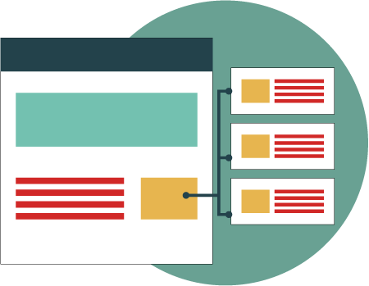
Project Features
Secure Mailbox is a web based and cross-platform supported application. Where user and admin play main role in whole project.
User features :
Admin Features :
Registration
Log-In
Password Recovery
View Email List(Sent/Receive)
Send Mail
Encrypt and Decrypt File
Live Chat
View Notification List
View Update Alert
Log In
Password Recovery
View User List
Create Update Alert

Slide 7








Implementation Tools & Technology
Technology
Database
Tools

Slide 8
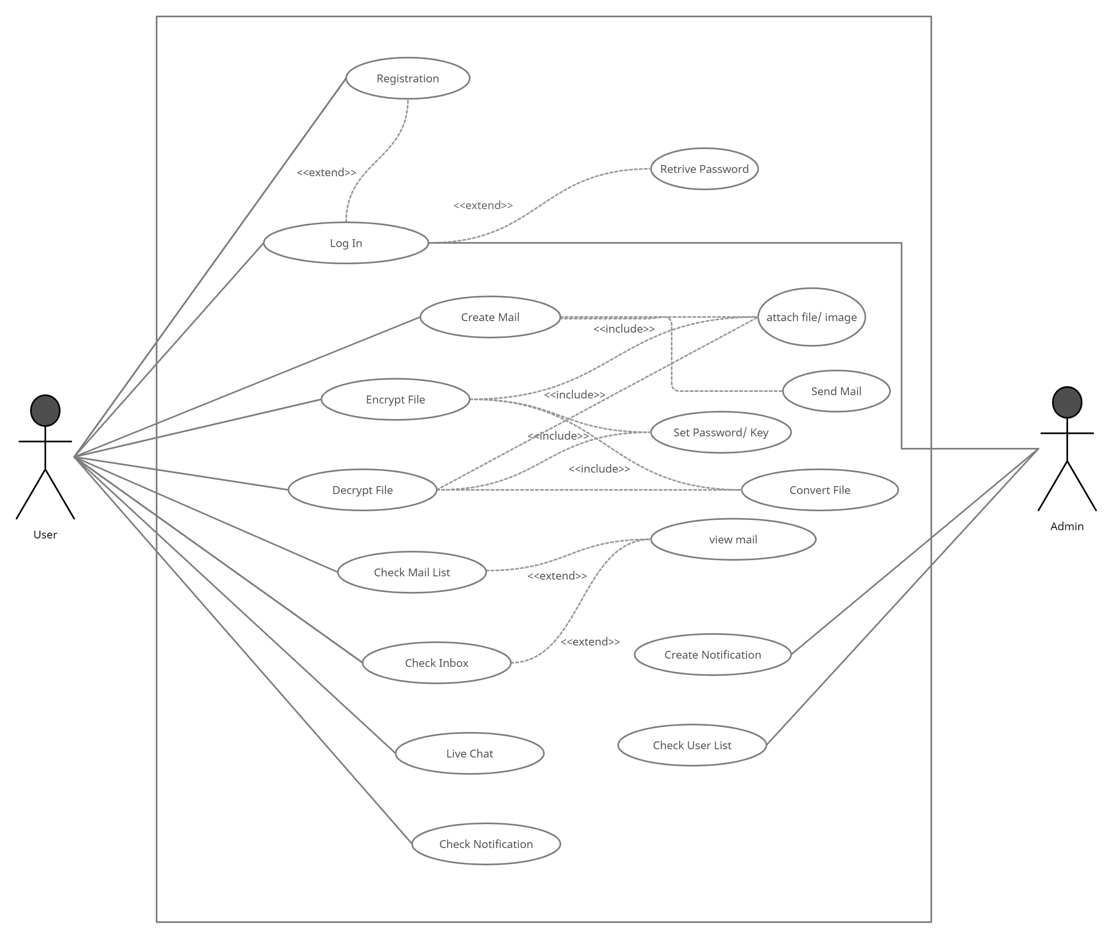
Use Case Diagram

Slide 9
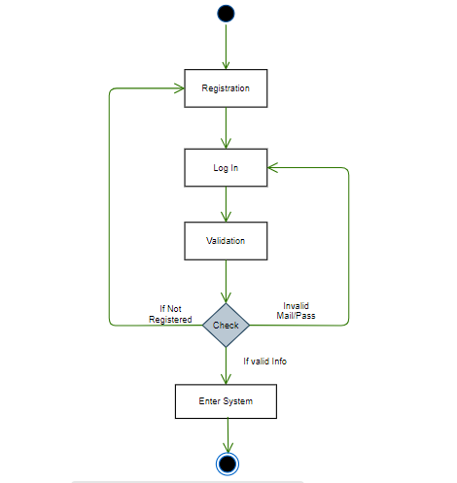
Login Activity Diagram

Slide 10
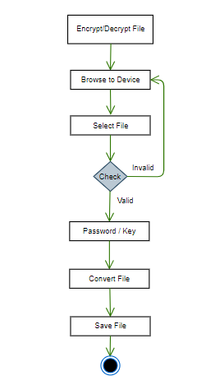
Encrypt/Decrypt File Activity Diagram

Slide 11
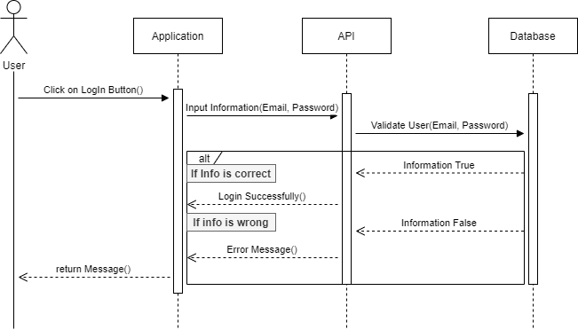
User Login Sequence

Slide 12
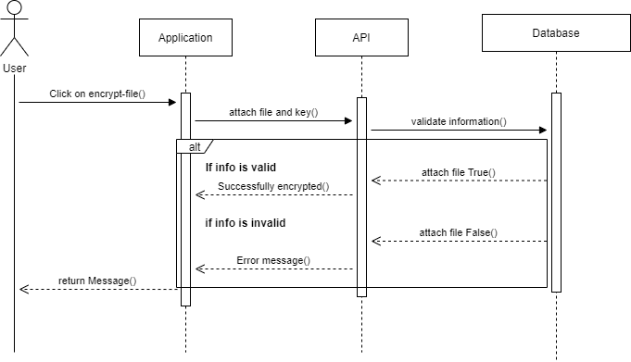
Encrypt File Sequence

Slide 13
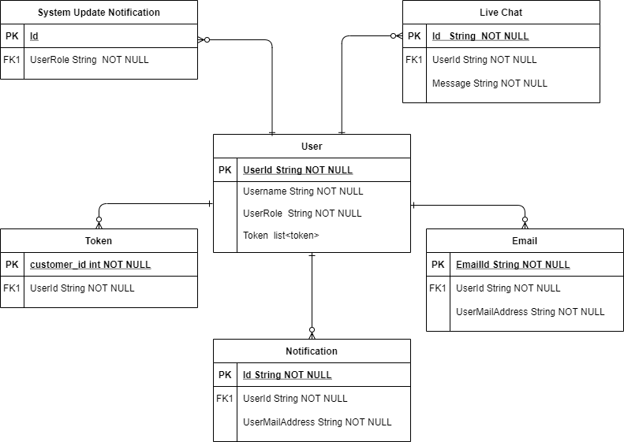
ER Diagram

Slide 14
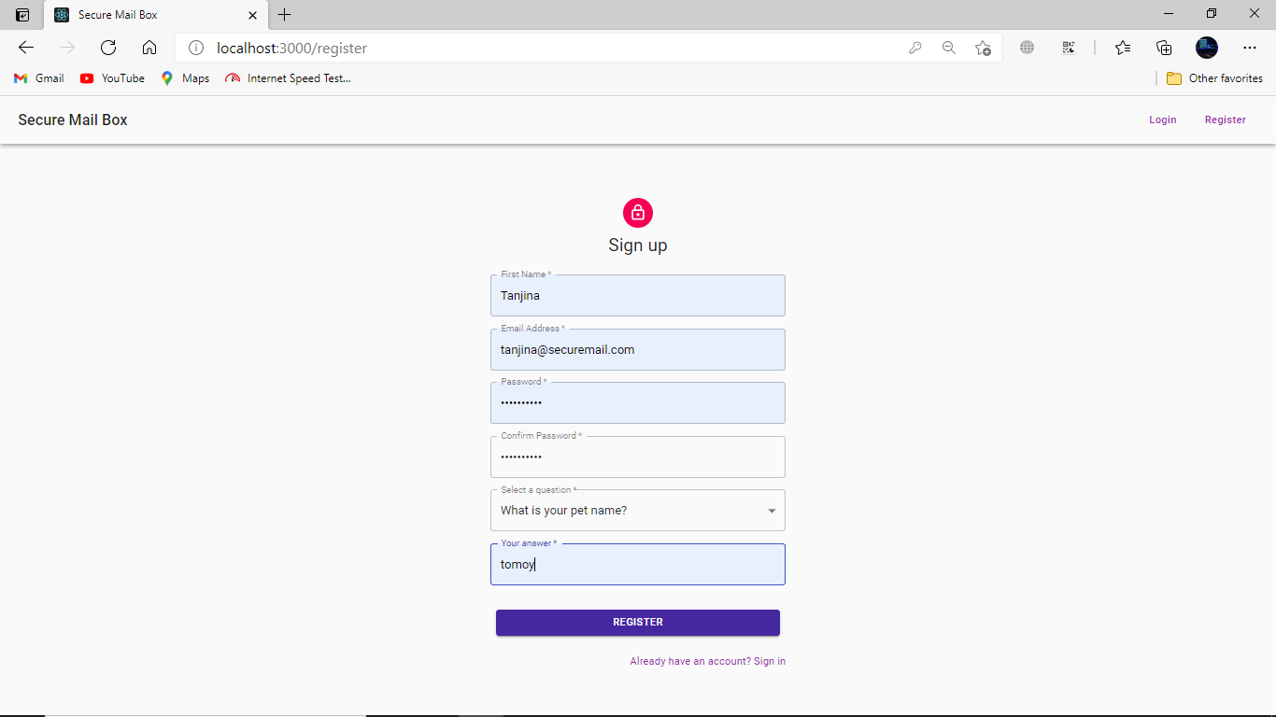
User Graphical Interface(GUI)
User Registration

Slide 15
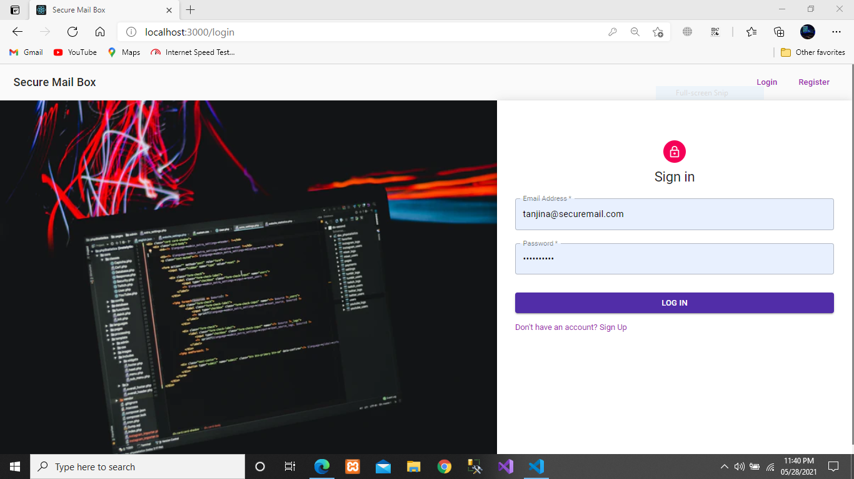
User Login

Slide 16
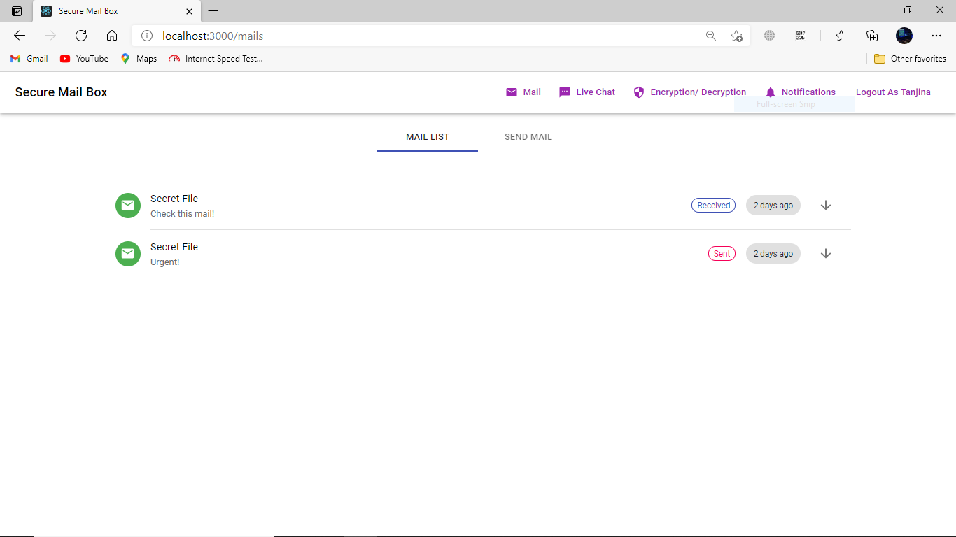
View Mail-List

Slide 17
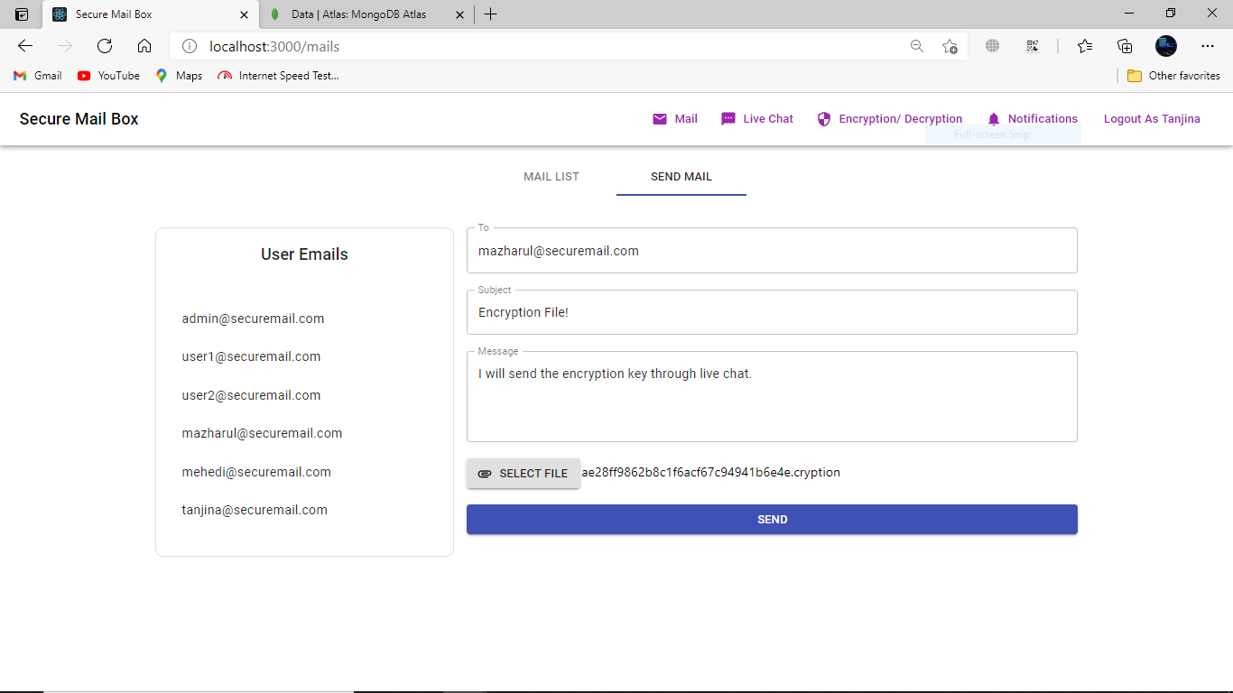
Create Mail

Slide 18
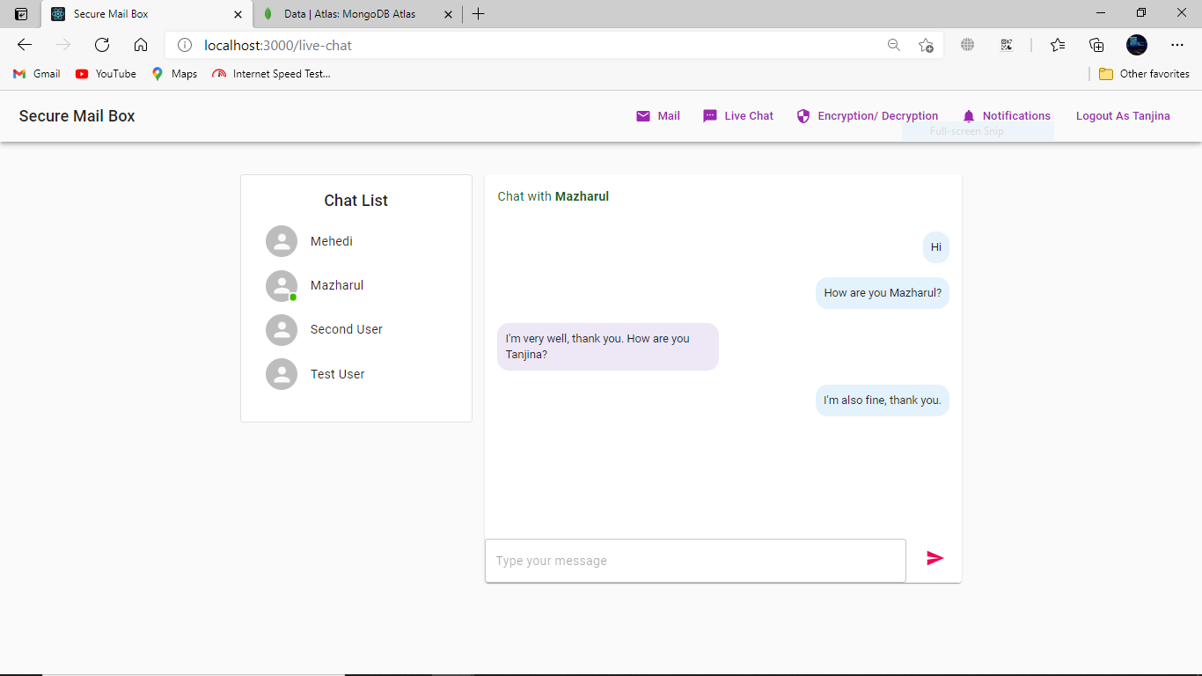
Live Chat

Slide 19
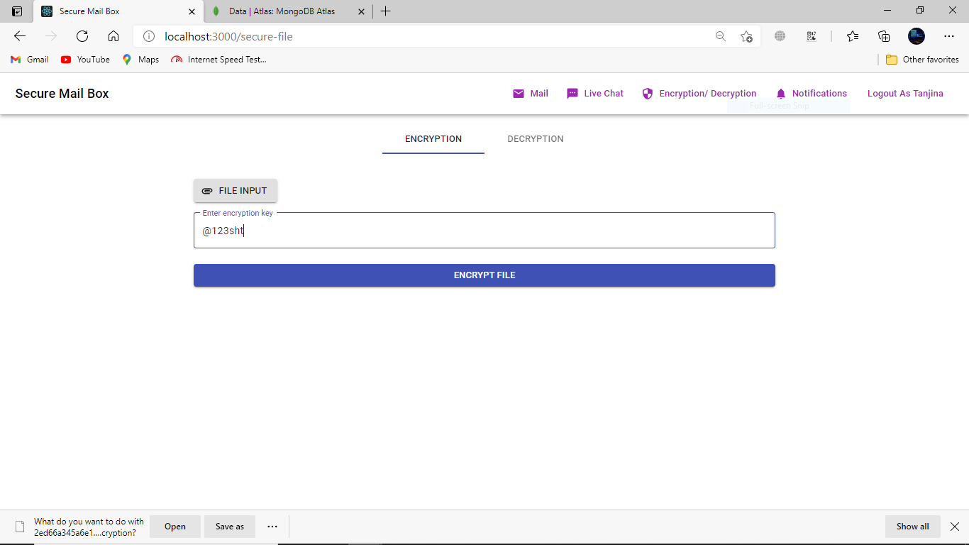
Encrypt File

Slide 20
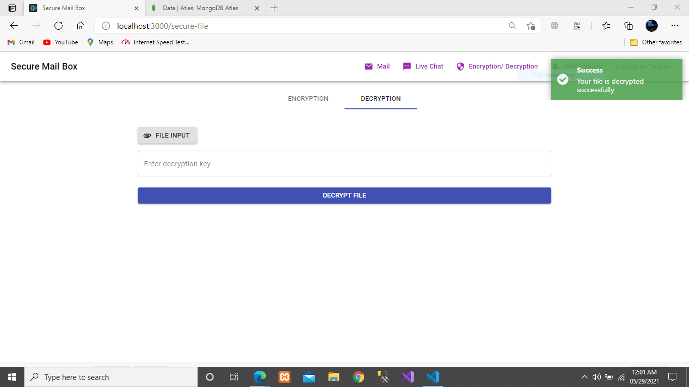
Decrypt File

Slide 21
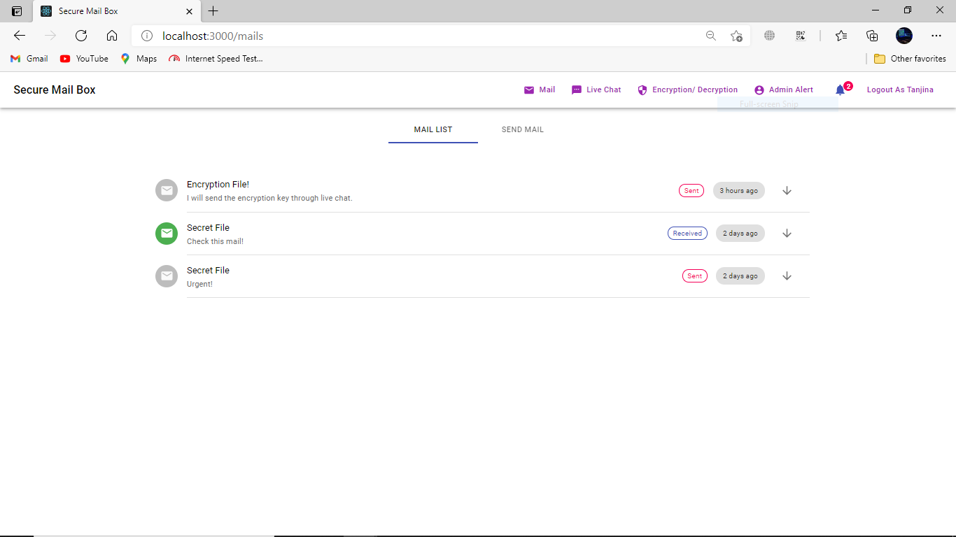
Notification List

Slide 22
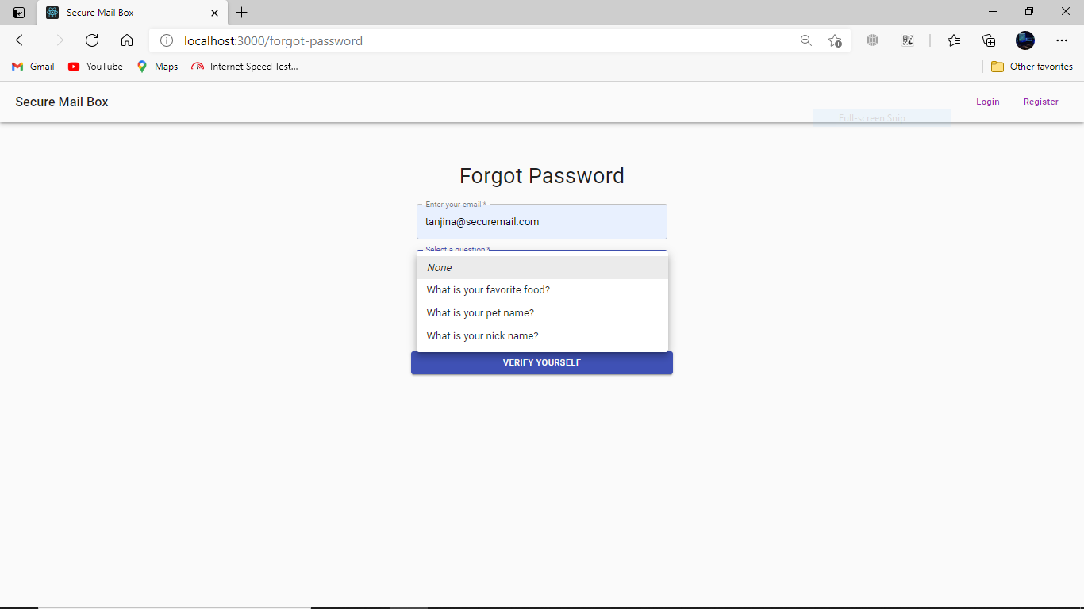
Forgot Password

Slide 23
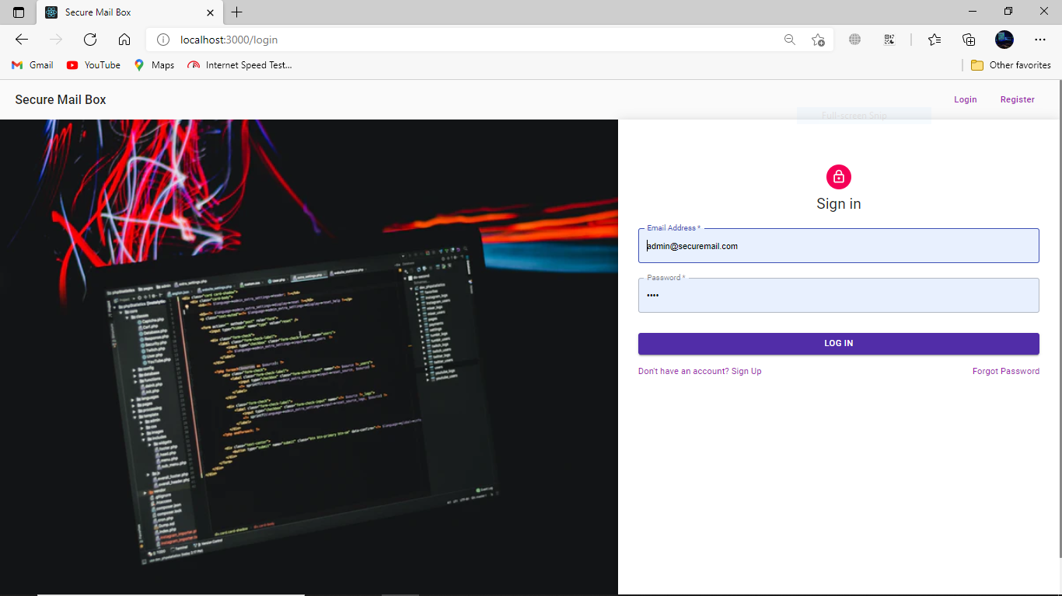
Admin Login

Slide 24
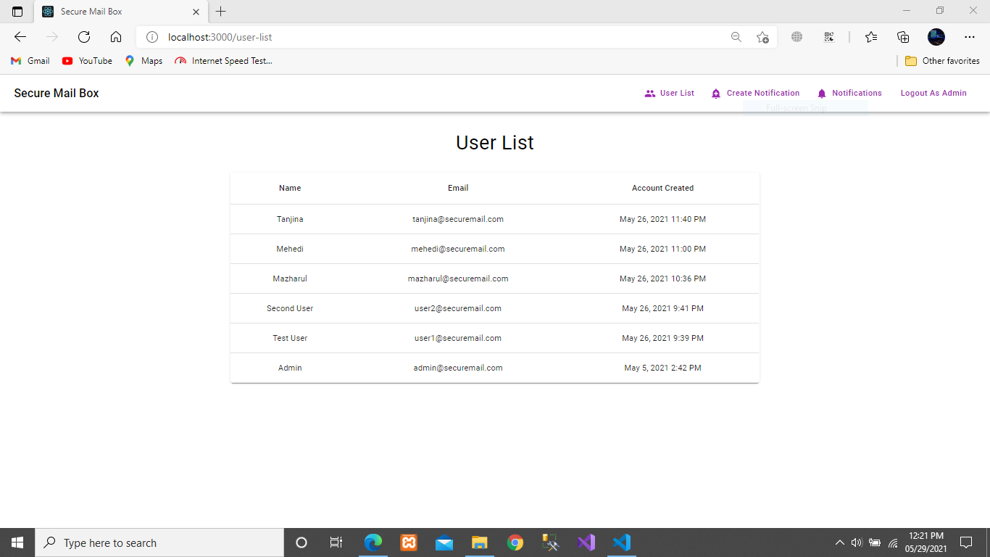
View User List

Slide 25
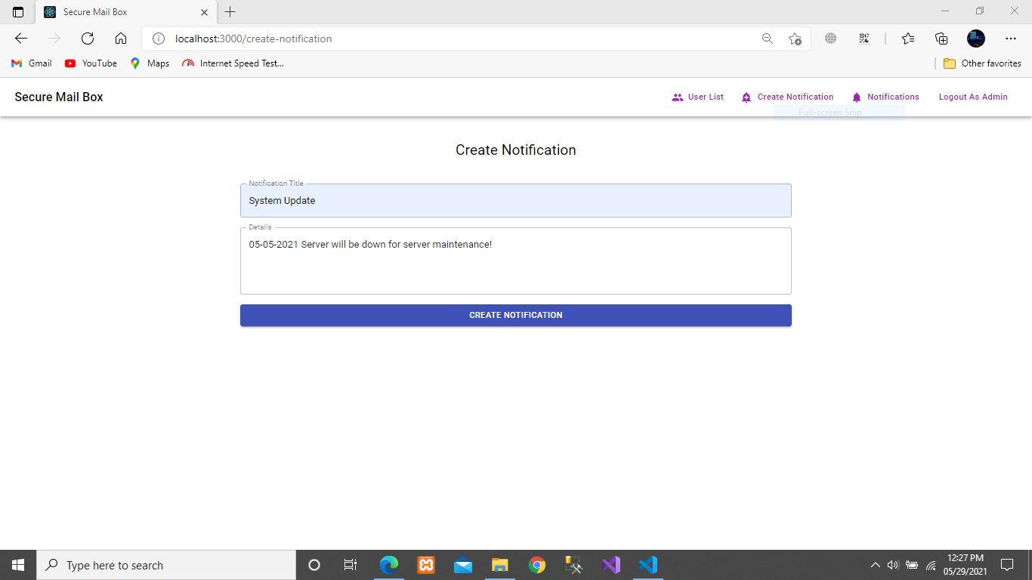
Create Update Notification

Slide 26

Future Scope
I will create some paid features which can be used by the paid users only.
System support will include for the user after building the paid features.

Slide 27

Github Link
MAZHARULISLAM11981/SecureMailbox (github.com)

Slide 28
Thank You!

Slide 29
END

